Slide 1
Fresh Grads – Group Project
Retail Store Management System
Yogesh Rahangdale - 46291849

Slide 2
Problem Statement
Login for Admin
Logout for Admin
Users should be able to create the bugs.
Admin should be able to perform below operations:
1. Manage Product
2. Manage Product Type
3. Manage Bill.
4. Cart

Slide 3
Plan
Design
Generate the skeleton as per class design provided
TDD approach
Identify test cases for each module
Write Failing Test cases
Convert the Test Cases in GREEN
Implement the case study in incremental manner

Slide 4
Modules
Manage Product
Manage Product Type
Manage Bill
Cart

Slide 5
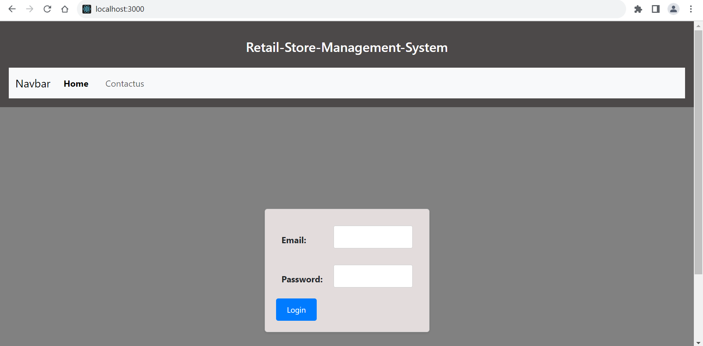

Slide 6
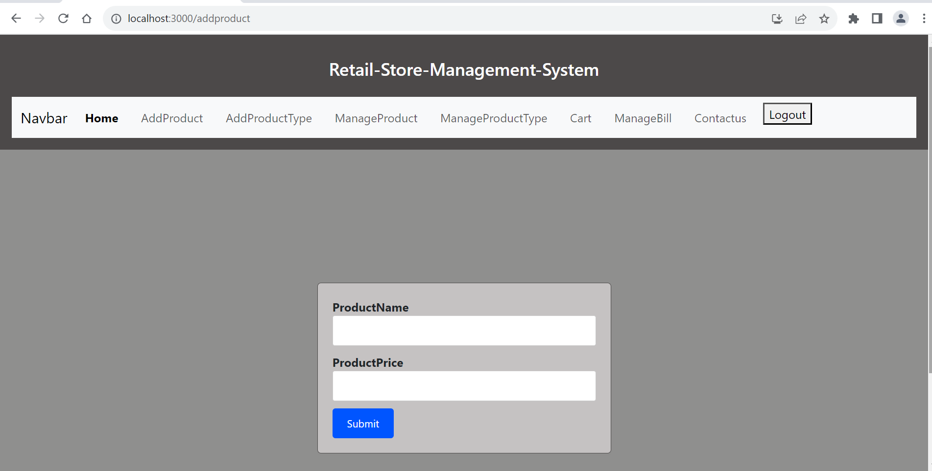

Slide 7
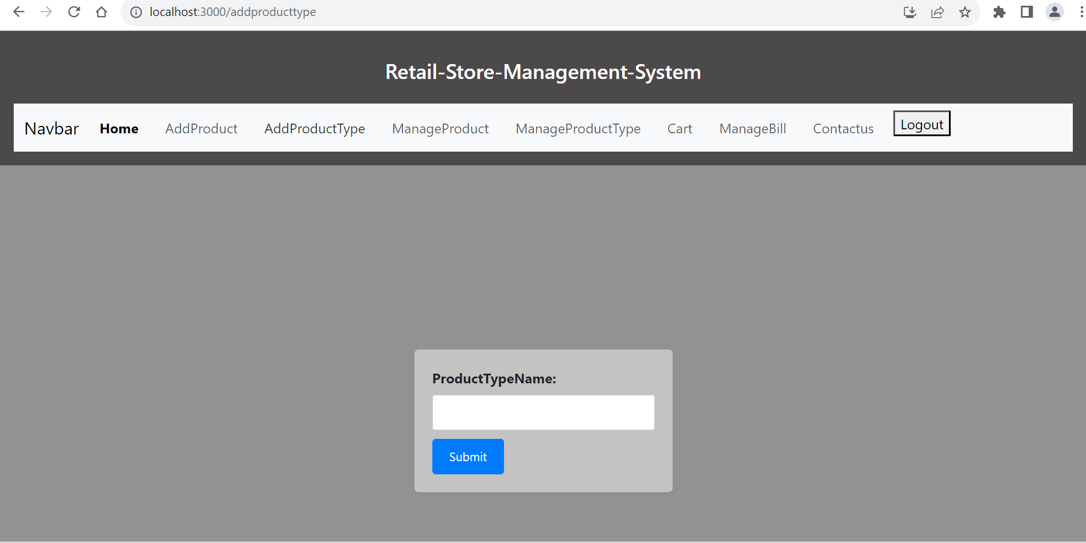

Slide 8
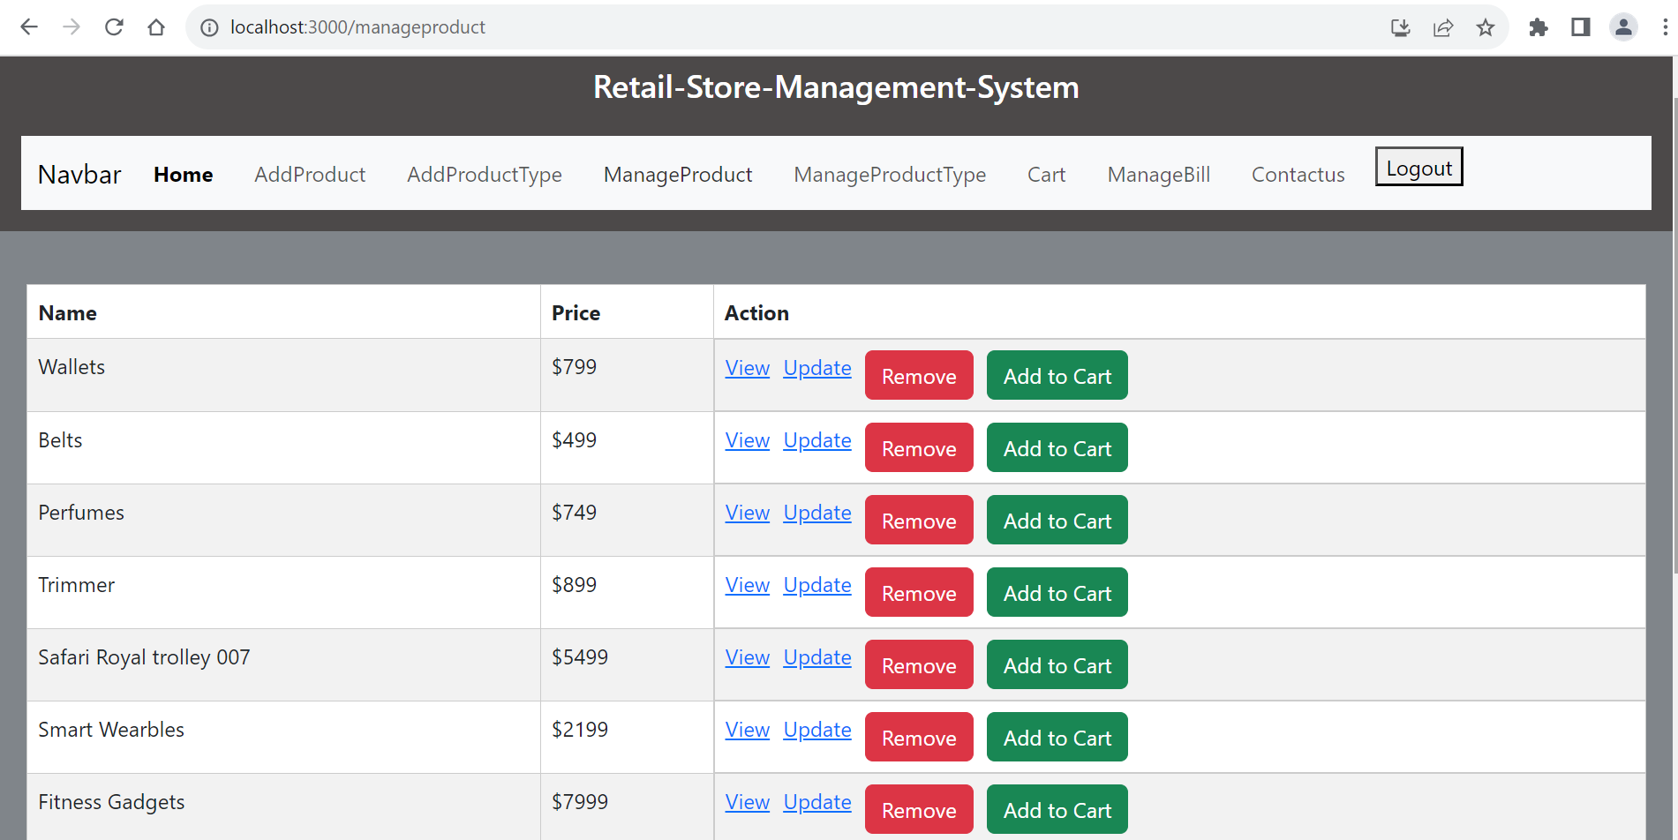

Slide 9
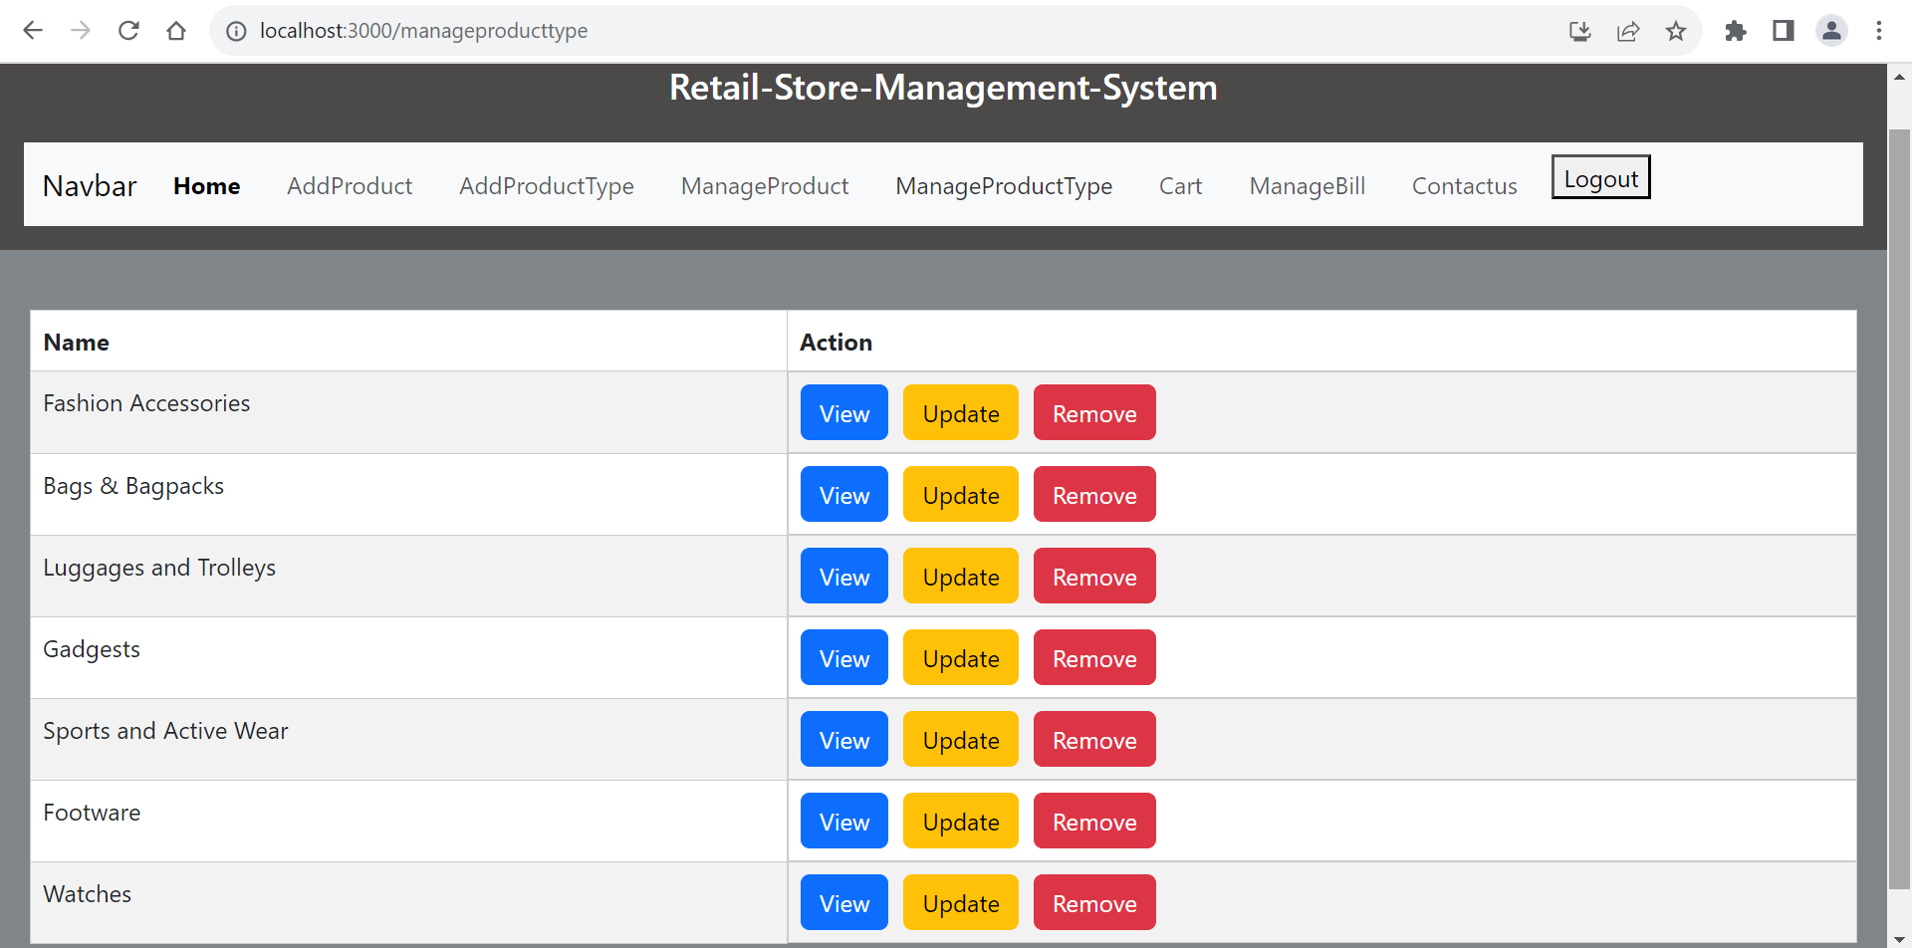

Slide 10
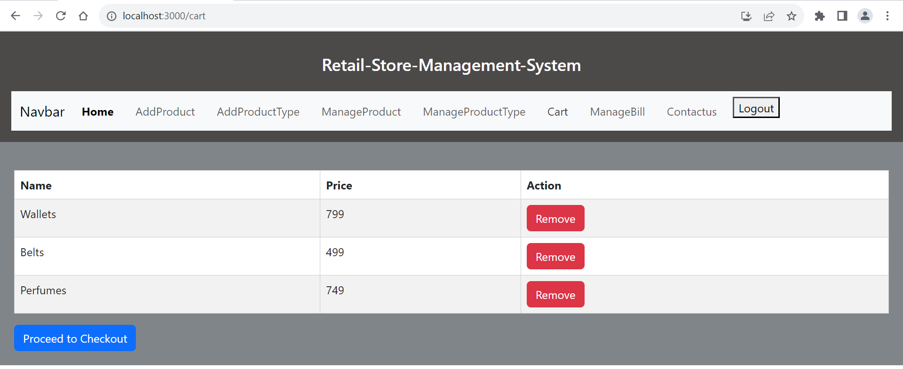

Slide 11
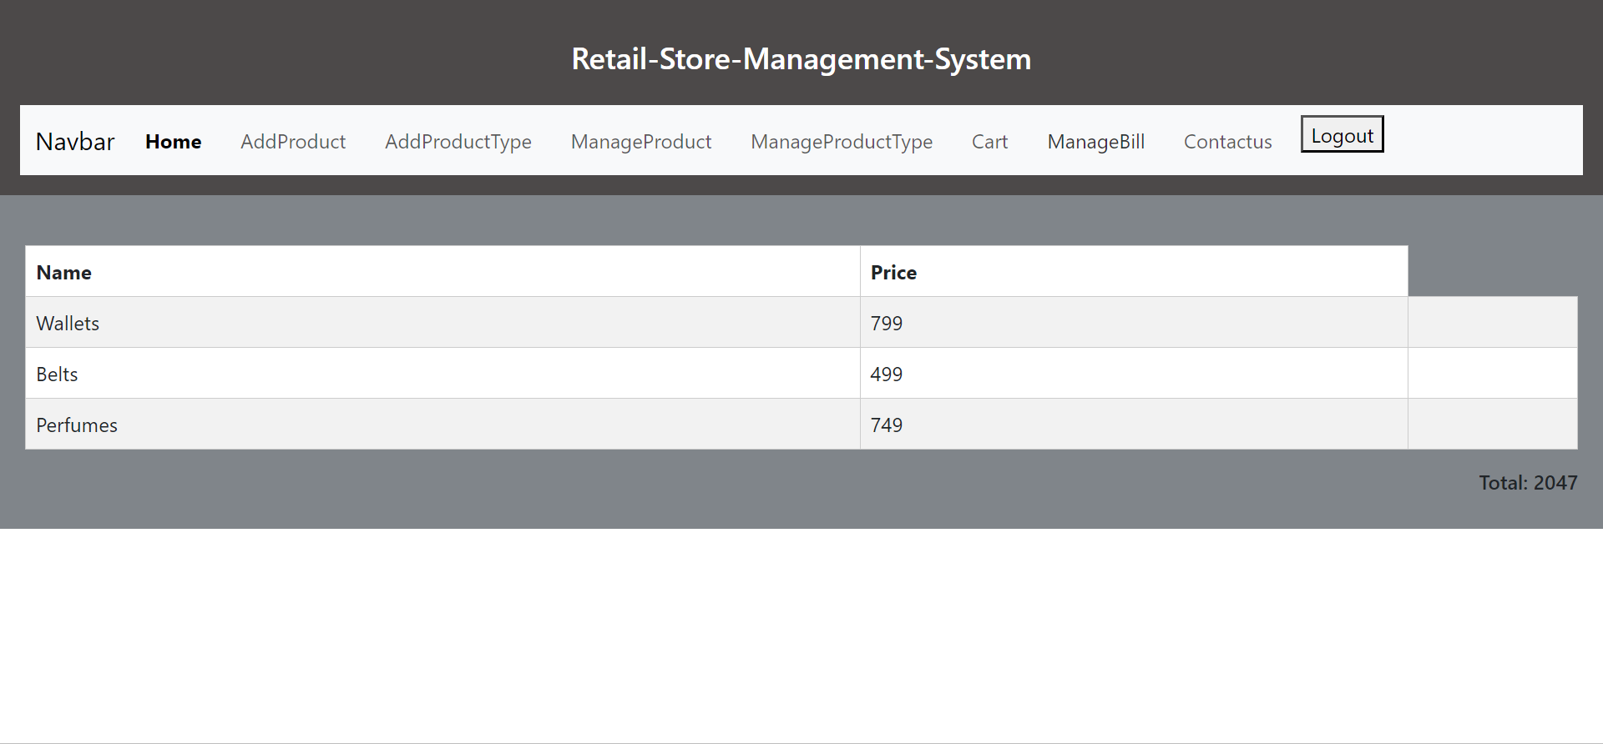

Slide 12
